Slide 1
Motion Detector
How to detect motion in a video using signal processing techniques

Slide 2
Agenda
The problem
Initial solution
Fine tune the solution
Demo
Bibliography

Slide 3
The problem
Detect moving objects in a video stream by using only signal processing techniques
Avoid using machine learning techniques

Slide 4
The solution
Build a pipeline consisting of background removal techniques and Fast Fourier Transform

Slide 5
The solution - initial solution -
Apply the Fast Fourier Transform on an array of frames taken from the original video stream:
Take every frame from the video and preprocess it by resizing and applying a Gaussian Blur filter
Convert the frames to grayscale
Compute 3D Fast Fourier Transform on the whole sequence of frames
Compute the phase angle
Compute phase spectrum array from the phase angle
Apply 3D inverse Fast Fourier Transform on the phase spectrum array
For every element in the array apply a Gaussian Blur filter in order to reduce the noise and convert it to a binary image using the mean as threshold
Find contours around the resulting white regions and eliminate the areas that are too small

Slide 6
The solution - initial solution -
The solution works most of the time but the results are not satisfactory
Maybe there are some ways to improve it

Slide 7
The solution - final solution -
In order to fine-tune the result, background removal techniques were added
It adds accuracy and also speed in processing the data by removing a huge amount of unnecessary data
Background removal was applied to the stream of frames taken from the video before applying Fast Fourier Transform
After some experiments, the pipeline with both techniques proved to give satisfactory results

Slide 8
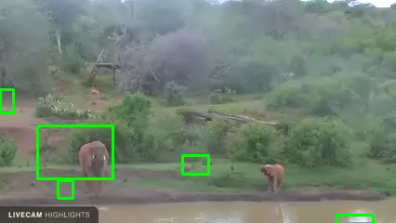
Demo

Slide 9
Downsides
This approach uses lots of hardware resources (memory and CPU)
It cannot differentiate between actual moving objects and apparent moving objects (like water or foliage)

Slide 10
Software
The project was written in Python using OpenCV for video manipulation

Slide 11
Bibliography
Weblinks:
https://dsp.stackexchange.com/questions/16462/how-moving-part-pixel-intensity-values-of-video-frames-becomes-dominant-compared
https://dsp.stackexchange.com/questions/23758/is-it-possible-to-do-single-vehicle-tracking-using-fourier-transform
https://www.youtube.com/watch?v=bSeFrPrqZ2A
https://www.gaussianwaves.com/2015/11/interpreting-fft-results-obtaining-magnitude-and-phase-information/
OpenCV documentation

